Slide 1
Domain Name System (DNS)
Thanmai D L
System Administrator I

Slide 2
What is DNS?
Phonebook of the Internet

Slide 3
Introduction to DNS
Humans access information online through domain names, like nytimes.com or espn.com. Web browsers interact through Internet Protocol (IP) addresses.
DNS, or Domain Name System, is a system used to translate domain names (such as www.example.com) into IP addresses (such as 192.0.2.1) and vice versa. It allows users to access websites and other resources using easily remembered names, rather than having to remember the numerical IP addresses.

Slide 4
How does DNS work?
Queries and hierarchical system of servers

Slide 5
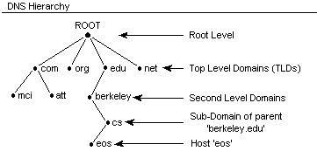
Hierarchical System of Servers
Recursive resolver: The DNS server that receives the initial request from a user's computer or device and is responsible for sending the query to other servers in the hierarchy.
Root servers: The top-level servers in the DNS hierarchy that contain information about the top-level domains (such as .com, .org, and .edu).
TLD servers: Servers that contain information about specific top-level domains (such as .com, .org, etc.).
Authoritative servers: The servers that contain the final information about a specific domain (such as the IP address for www.example.com).

Slide 6
DNS Queries
Recursive query: In a recursive query, a DNS client requires that a DNS server will respond to the client with either the requested resource record or an error message if the resolver can't find the record.
Iterative query: In this situation the DNS client will allow a DNS server to return the best answer it can. If the queried DNS server does not have a match for the query name, it will return a referral to a DNS server authoritative for a lower level of the domain namespace. The DNS client will then make a query to the referral address. This process continues with additional DNS servers down the query chain until either an error or timeout occurs.
Non-recursive query: Typically, this will occur when a DNS resolver client queries a DNS server for a record that it has access to either because it's authoritative for the record or the record exists inside of its cache. Typically, a DNS server will cache DNS records to prevent additional bandwidth consumption and load on upstream servers.

Slide 7
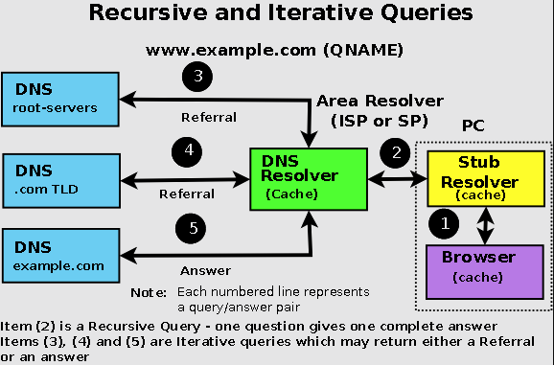
The Resolution

Slide 8
The Resolution
A user types ‘example.com’ into a web browser and the query travels into the Internet and is received by a DNS recursive resolver.
The resolver then queries a DNS root nameserver (.).
The root server then responds to the resolver with the address of a Top-Level Domain (TLD) DNS server (such as .com or .net), which stores the information for its domains. When searching for example.com, our request is pointed toward the .com TLD.
The resolver then makes a request to the .com TLD.
The TLD server then responds with the IP address of the domain’s nameserver, example.com.
Lastly, the recursive resolver sends a query to the domain’s nameserver.
The IP address for example.com is then returned to the resolver from the nameserver.
The DNS resolver then responds to the web browser with the IP address of the domain requested initially.

Slide 9

DNS Caching
Cache is King

Slide 10
DNS Caching
DNS caching involves storing data closer to the requesting client so that the DNS query can be resolved earlier and additional queries further down the DNS lookup chain can be avoided, thereby improving load times and reducing bandwidth/CPU consumption.
DNS data can be cached in a variety of locations, each of which will store DNS records for a set amount of time determined by a time-to-live (TTL):
Browser DNS caching
Operating system (OS) level DNS caching
Router DNS caching
ISP resolver DNS caching
Notes:
Introduce DNS cache poisoning

Slide 11
DNS Protocol
Getting into the specifics

Slide 12
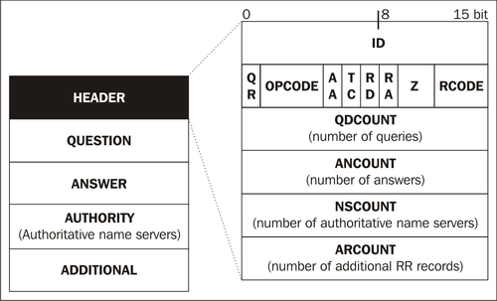
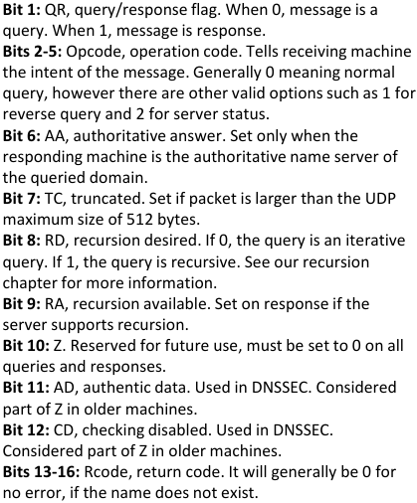
DNS Protocol Header
Notes:
Live demo of DNS lookup using dig+trace or portal

Slide 13
DNS Protocol Header
Question: In general, there will only be one question, or query, per packet. The question is made up of three parts: the query name, which would be a host name such as www.google.com, a question type, and a question class, which is almost always 1 or IN for internet.
Answer Resource Records: The “Answer” section is present on the response from recursive resolver to an end user’s computer, or in the response from the authoritative name server of the domain to the recursive resolver.
Authority Resource Records: When a name server like TLDs do not have the answer to the query (as it is not authoritative), it will not send answer records. Instead, it will populate the authority section with all the name servers that it knows as authoritative to the domain or part of the domain tree (like .com), if it has them.
Additional Records: Additional or "glue" records help avoid additional recursion by providing the IP addresses (A or AAAA records) of the NS records sent in the authoritative or answer section, so that those domains do not need to be resolved.

Slide 14
DNS Zones
What are DNS zones? Why are they used?

Slide 15
DNS Zone and Zone Files
A DNS zone is a portion of the domain name space that is managed by a specific group of DNS servers. Each zone is responsible for a specific subdomain or set of subdomains and contains the resource records (such as A records and MX records) that map domain names to IP addresses and other information.
Zone files contain Resource Records that describe a domain or sub-domain. A zone file will consist of the following types of data:
Data that indicates the top of the zone and some of its general properties (a SOA Record).
Authoritative data for all nodes or hosts within the zone (typically A or AAAA Records).
Data that describes global information for the zone (including mail MX Records and Name Server NS Records).
In the case of sub-domain delegation, the name servers responsible for this sub-domain (one or more NS Records).
In the case of sub-domain delegation one or more glue records that allows a name server to reach the sub-domain (typically one or more A or AAAA Records) for the sub-domain name servers.
Notes:
Reverse Lookup zone, Primary and Secondary DNS servers

Slide 16
DNS Zone Transfers
A DNS zone transfer is the process of copying a DNS zone file from one DNS server to another. Zone transfers are used to keep multiple DNS servers in sync and ensure that all servers have the same information about a specific zone.
There are two types of zone transfers:
AXFR (Full Zone Transfer): This type of zone transfer copies the entire zone file from the primary server to the secondary server. This is used when a secondary server is first set up or when a significant change to the zone file has been made.
IXFR (Incremental Zone Transfer): This type of zone transfer only copies the changes made to the zone file since the last zone transfer. This is more efficient than AXFR, as it only transfers the changes, rather than the entire zone file.
When a zone transfer occurs, the primary server and the secondary server use the DNS protocol to communicate. The secondary server sends a request for the zone file to the primary server, and the primary server responds with the requested information.

Slide 17
DNS Records
Different types of records

Slide 18
A, AAAA, CNAME, MX, NS and more.
A (Address) record: This is the most basic type of DNS record and maps a domain name to an IP address.
AAAA (IPv6 Address) record: This is like the A record, but it maps a domain name to an IPv6 address instead of an IPv4 address.
MX (Mail Exchange) record: This record maps a domain name to the server responsible for handling email for that domain. The MX record contains the hostname of the mail server and a priority value.
CNAME (Canonical Name) record: This record maps an alias domain name to the true, or "canonical," domain name.
NS (Name Server) record: This record maps a domain name to the server that is authoritative for that domain.

Slide 19
A, AAAA, CNAME, MX, NS and more.
PTR (Pointer) record: This record is used for reverse DNS resolution. It maps an IP address to a hostname, allowing a client to determine the hostname associated with a particular IP address.
TXT (Text) record: This record is used to store any text-based information associated with a domain name. It can be used for various purposes such as for SPF, DMARC and other email validations.
SRV (Service) record: This record is used to define the location of a specific service for a domain. It specifies the hostname and port number of the server providing the service.

Slide 20
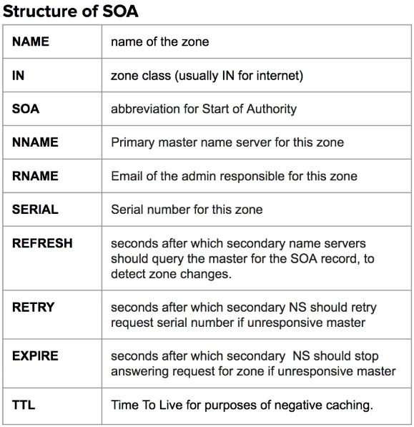
SOA Record
This record appears at the beginning of a zone file and provides information about the zone, including the primary server responsible for the zone, the email address of the zone administrator, and various time-to-live (TTL) values used by the zone.

Slide 21
SPF Record
SPF (Sender Policy Framework) records are a type of DNS record that are used to specify which mail servers are authorized to send email on behalf of a specific domain. They are used to prevent email spoofing by allowing domain owners to specify which mail servers are authorized to send email from their domains.
For example, let's say a company called XYZ has a mail server called "mail.xyz.com" that is responsible for sending email from the domain "xyz.com". To prevent email spoofing, the administrator would create an SPF record that looks like this:
xyz.com. IN TXT "v=spf1 a mx ip4:192.0.2.1/24 -all"

Slide 22
More on DNS
Miscellaneous topics

Slide 23
Primary and Secondary DNS
A primary/master DNS server is a server that hosts a website’s primary zone file. Primary servers are also responsible for making any necessary changes to a zone’s DNS records.
A secondary/slave DNS server contain zone file copies that are read-only, meaning they cannot be modified. Instead of getting their information from local files, they receive pertinent information from a primary server in a communication process known as a zone transfer.
Benefits of using a secondary DNS server:
Redundancy and resiliency
Load balancing (using Round-Robin DNS)

Slide 24
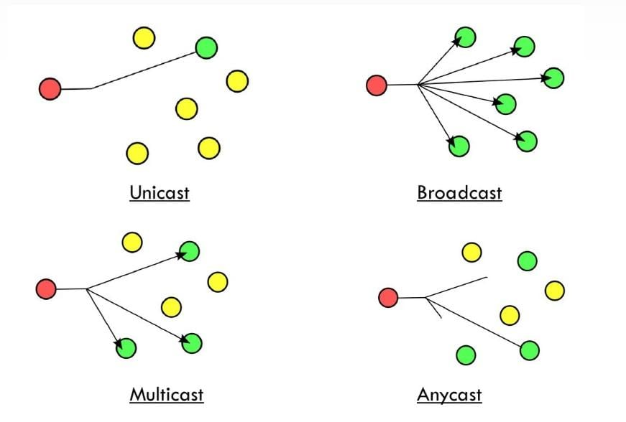
Anycast DNS
In Anycast, one IP address can apply to many servers. Anycast DNS means that any one of several DNS servers can respond to DNS queries, and typically the one that is geographically closest will provide the response. This reduces latency, improves uptime for the DNS resolving service, and provides protection against DNS flood DDoS attacks.
One-to-One of Many.

Slide 25
DNS Reverse Mapping
A reverse DNS lookup is a DNS query for the domain name associated with a given IP address.
Reverse DNS lookups query DNS servers for a PTR (pointer) record; if the server does not have a PTR record, it cannot resolve a reverse lookup.
PTR records store IP addresses with their segments reversed, and they append ".in-addr.arpa“ for IPv4 and ".ip6.arpa“ for IPv6.
Reverse lookups are commonly used by email servers. Email servers check and see if an email message came from a valid server before bringing it onto their network. Many email servers will reject messages from any server that does not support reverse lookups or from a server that is highly unlikely to be legitimate.

Slide 26
Dynamic DNS(DDNS)
Dynamic DNS (DDNS) is a service that keeps the DNS updated with a web property's correct IP address, even if that IP address is constantly being updated.
If a web administrator is operating a small website with a domain name of www.example.com and an IP address of 192.0.2.0, anytime another user enters www.example.com into their browser, the DNS will direct them to the server at 192.0.2.0. If the admin's ISP dynamically changes the IP to 192.0.2.1, a dynamic DNS service can automatically update the admin's DNS records so that other users trying to visit www.example.com will now go to the correct IP address.
One very common method of enabling dynamic DNS is by providing users with software which runs on their computer or router. This software communicates with the dynamic DNS service provider anytime the IP addresses provided by the ISP is updated, and the dynamic DNS provider in turn updates the DNS with those changes, providing almost instant updates.

Slide 27
References
DNS and BIND - 5thedition
DNS for Rocket Scientists
Cloudflare – Learning Center

